Slide 1

MAKING WORKING SAFELY A REALITY
www.be-safetechnologies.com

Slide 2
The Compliance Genie™
- What Does It do -
A ‘’state of the art’’, all in one digital H&S application which works both at your HQ and on site
The service works via any mobile device or on your desktop
The Compliance Genie™ will enable your organization to be fully compliant in all H&S work scenarios
Providing first class real-time reporting and data
Significant Return On Investment

Slide 3

Problems…
Compliance in relation to Health and Safety in the workplace and while on site must be achieved
Ever changing rules and regulations must be followed - by law
The safety of every employee is the responsibility of every company and their Directors
There are often multiple different processes and checklists, and assessments and documentation must all align
Management of the processes is convoluted and inefficient – and all on paper!
Time consuming paperwork costs money
Current technology is varied and unconnected – often siloed solutions to achieve one goal
Apps do one thing but not another
Fines and litigation can be damaging and huge

Slide 4

WHO ARE WE?
WE ARE EXPERIENCED IN:
Developing and operating complex Technology Platforms
Delivering of innovative solutions
Running successful national and international companies
Operating within all vertical markets with a requirement for Health and Safety
Health and Safety Management

Slide 5

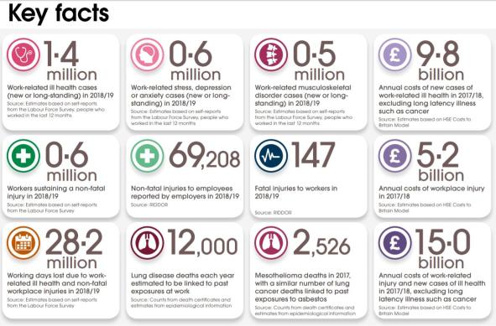
KEY FACTS
KEY FACTS

Slide 6

BeSafe can help to reduce incidents/accidents/create a better working environment
There is now a technology tool that makes complying with ALL these H&S rules and regulations both easy and cost effective
Delivers Significant ROI
The Compliance Genie™ does all of this – and more! – in one platform

Slide 7


The Compliance Genie
Cloud Based (SaaS) Solution
Health and Safety Management Suite
Modular Solution Covering all key aspects of H&S including:
  Visitor Management
  Document Distribution and Sign off
  Checklist Completion
  Action Tracking
  Training Records Management
  Asset Management
  Permit Management

Slide 8

Why Use Be-Safe?
Empower your workforce
Make your workforce accountable
Remotely monitor and manage your employees
Give senior management piece of mind
Robustly store key safety documentation and track its sign off
Build bespoke dashboards to your sets of KPIs
Manage by visibility
Receive real time reporting
Define custom escalation logic to notify the RIGHT people
Save money by minimizing management costs
Avoid Litigation and fines

Slide 9

HOW?
Cloud Based to ensure accessibility and flexibility
Manage your workforce from anywhere in the world and in any language
License based solution where each member of the team has a license
Bespoke user modes are crucial to success, allowing both employed and subcontractor access
Enables you to track ALL your workforce and allows all of your workforce to benefit

Slide 10



Bespoke User Modes
We have created bespoke modes to ensure simplicity and flexibility:
Dedicated Mode
For shared / project specific device
This device will remain on a site and hold ALL data relevant to that site allowing supervisors, managers, employed workforce, and subcontractors to log in and access all data relevant to that site/project
HSE will find ALL relevant information at the touch of a button should they require it
Personal Mode
Designed for use by remote/roaming engineers/managers
Allowing them to access different projects/sites equipment and personnel details
Desktop Mode
Providing your office-based staff total access (credentials dependent)
Access to all aspects of the service including individual site/projects, detailed system information in addition to comprehensive dashboards which deliver real-time and historical core data.
Access to the Compliance Genie™ will allow senior admin access to core functionality too

Slide 11
Example user modes functionality
Create and distribute risk assessments quickly and track sign off
Create your own induction process
Uniquely identify each employee, visitor, and delivery
Automated inductions covering the salient points relevant to that individual
Automatically notify users when new documents are issued
Prompt review and track the status of the document sign off
Highlights actual and potential issues/accidents/concerns

Slide 12

What does it do? – Custom Notifications
Generate custom notifications
Automatically notify workers without the correct training records that they are unable to complete certain tasks or operate specific pieces of equipment
All submissions and sign-in records can be tracked via GPS
All certificates linked to individuals

Slide 13


What does it do? - Make it simple to use through the best technology – QR Codes
Be Safe use QR Codes through the whole of its platform allowing
Simple sign on
Fast access to equipment - just scan the QR and you will be identified and allowed access (assuming your profile allows access)
Check the validity of equipment – scan the QR and you will be provided the history and maintainability of a machine, tool, or device
Need to track HAVS – scan the QR on a device and this will evoke the HAV’s virtual calculator for your profile
All QR Code data is stored to enable The Compliance Genie™ to produce management data
Our QR Code technology has countless potential functionalities

Slide 14
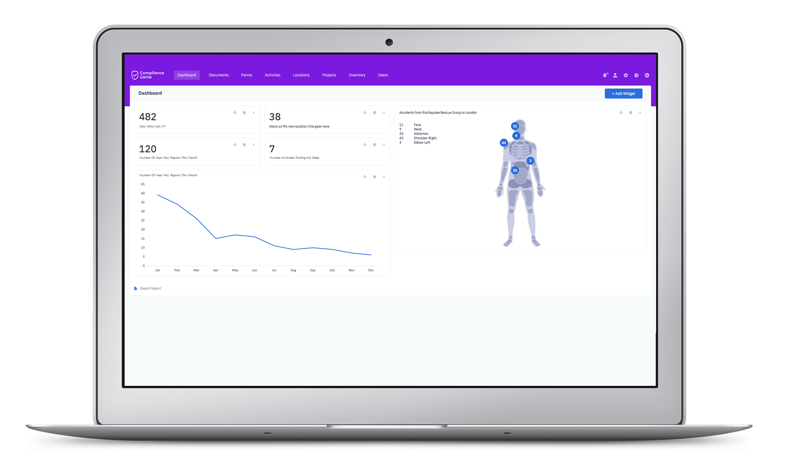
Increased Visibility Through Dashboards
Create customized dashboards relevant to different individuals KPI’s
Real time data
Bespoke dashboards for each member of the team
Automatic reports
Schedule distribution of reports to key members of the management team

Slide 15
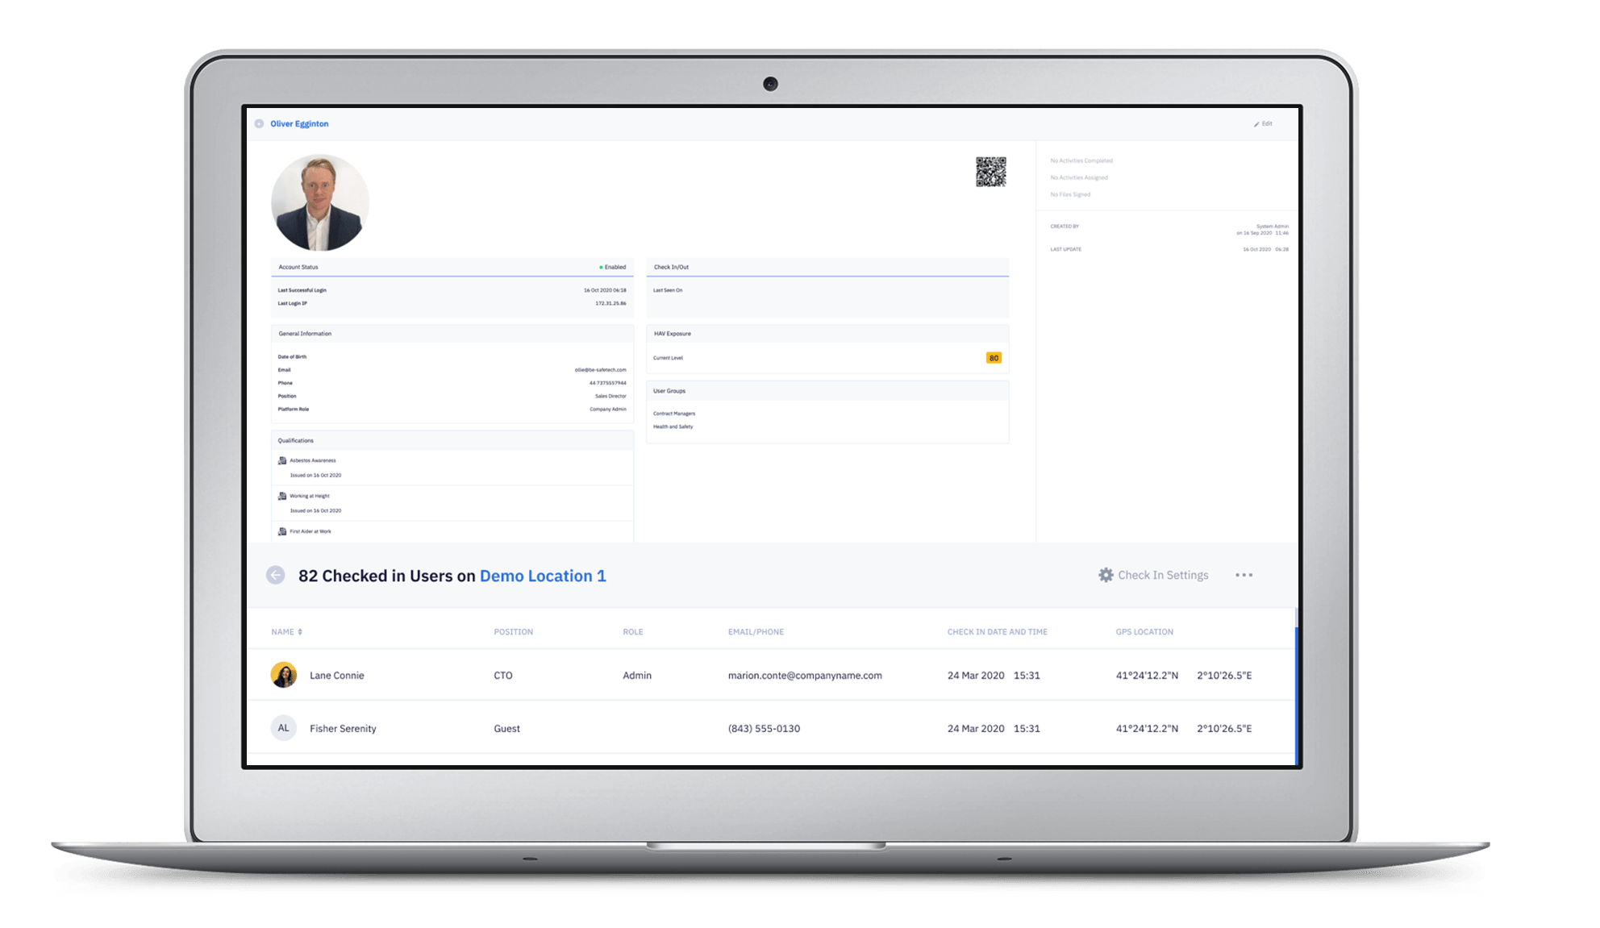
Employee and Sub-Contractor Management
Manage your entire workforce, directly employed or sub contracted within one system
Store all training records within each individuals profile.
Define qualification expiries and automate notifications
Track all signed documents by individual and have them robustly stored in one place
View the sign in records by individual to track time on site.

Slide 16
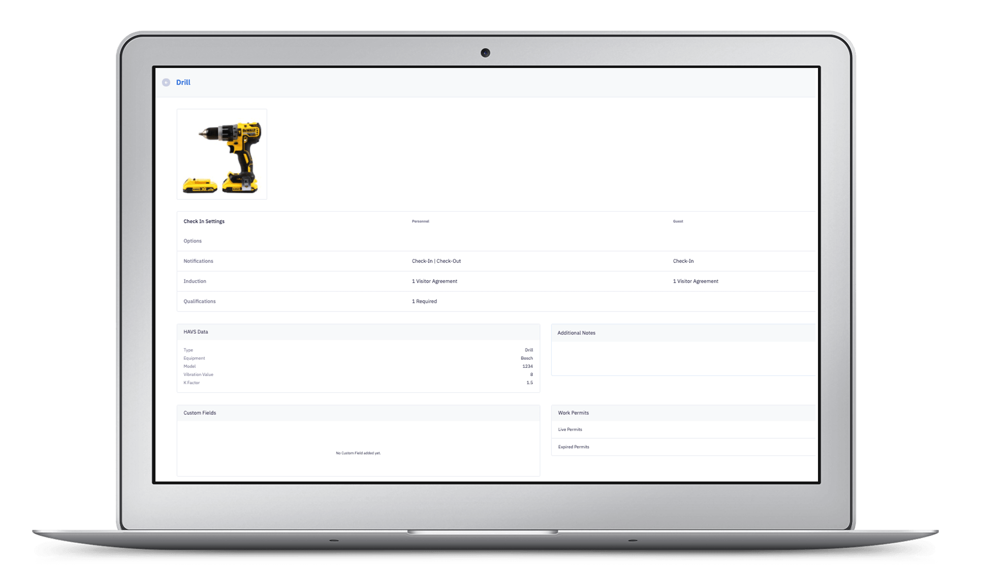
Manage you Company Inventory
Create and manage company owned inventory items
Store key documentation against the inventory item including manuals and drawings
Create bespoke checklists for inspection and store completed copies against the item
Store HAVs data against hand held tools and utilise our HAVs calculator to keep your workforce safe from HAVS
Define training requirements for equipment use

Slide 17

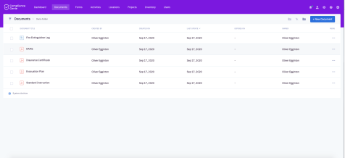
Document Management
Robustly distribute documents to your remote workforce and capture proof of receipt
Build robust processes to streamline document signoff and acknowledgement
Distribute document revisions seamlessly and automatically remove previous revisions from circulation
Define document owners and schedule document review intervals as required
Capture not only the digital ink signature but also the GPS co-ordinates and a photo of the recipient at the point of signature

Slide 18

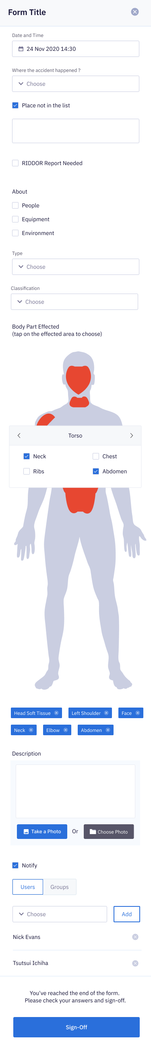
Digital Checklists and Activities
Create custom checklists and distribute to remote members of the team
Schedule checklist completion making your team accountable for the completion
Automate prompts and escalations if inspection deadlines are missed or expire
Collect and report upon data in real time and have your checklists popular custom dashboards and reports
Make the completion process more logical and user friendly whilst standardising completion formats and answer options

Slide 19

Tony Davies
Central Roofing South Wales - Managing Director

Slide 20



Paper v Digital
Traditionally, formal reports, updates and notifications get communicated every month
Managers receive localised reports with little visibility for the rest of the team
Very convoluted and lengthy process to manage corrective action closeout
Delays inevitably disrupt site activities
Digitisation has allowed for live real-time reporting throughout the business
I can now instantly generate a custom report drilling down into the detail I want to know
Receive progress updates and snags in a concise and robust format

Slide 21

All in One Place
Reduce the number of team members involved when fact finding
Move away from the traditional project WhatsApp group chat or email string
Locate all documents and data in one place
View real time site/project specific data collected in the field
Allow for easy management access
Receive regular photos and summaries of activities
Empower teams to take ownership providing us with visibility across our site/s

Slide 22
What’s your digital ROI? - Realizing the value of digital investments
Cost to create a traditional site file circa £500 per project | Now closer to £50 thanks to our digital platform
It was extremely costly maintaining site records and supply of blank forms | Now this is fully automated and we can create an unlimited number of digital
No need to copy paper files and print 100’s of documents | Now available on all devices anywhere in the world
No need to distribute revisions of documents to site | Now instantaneously distribute a revision and track its receipt and sign off
No Need to rent costly storage units to archive box files | Now instantly accessible in the relevant project file without our system
We are saving around 40% of management costs per project

Slide 23
What’s your digital ROI? - Realizing the value of digital investments
Tens of thousands of pounds are being saved across our business
Auditing has become an automatic process
Providing reusable deep data
Its all automated !!
And that’s not all
We are seeing very significant ROI’S across the business
Skilled senior members of the team no longer audit paper trails
Reduced admin involvement
Operational efficiencies driven

Slide 24

Piece of mind - at all times, digitally
Remote management
Increased visibility of our Health and Safety Status for all
Helped change internal culture in respect to H&S and drive transparency
I understand my H&S performance every day across all of my sites within minutes
Be confident our workforce and customers are safe
Our employees now follow step by step processes on site to ensure usability
All employees know what they can and cant do based on their skillsets and the system knows too!
Manage sub-contractors in the same way in the same app
Directors and HSE managers know that all HSE procedures are being followed and are automatically notified by the system if they’re not.
Everyone is safe, secure and importantly more efficient too
Be-Safe Technologies Ltd confidential

Slide 25
Compliance Genie™ Benefits
STREAMLINE THE MANAGEMENT OF YOUR REMOTE WORKFORCE
Enable your management to be in multiple places at the same time – without leaving their desk!
Modular Solution Covering all key aspects of H&S
Capture incidents, monitor trends and assign individuals
Ensure robust corrective actions are implemented
Live Dashboards to manage more easily
Virtual HAVS data fully integrated
Saves Money and Time
Avoid litigation accidents and fines
All-In-ONE App

Slide 26


